Slide 1
Other Income
Pub 17 Chapter 12
Pub 4012 Tab D
(Federal 1040-Line 21)
(NJ 1040 –Lines 23 & 25)
Notes:
1

Slide 2
Other Income Federal 1040 Line 21
Includes income not reported on other Lines & Schedules
Of info reported on 1099-MISCs, only Box 3 or 8 is included on 1040 Line 21
Amounts in other boxes go on other 1040 schedules, not Line 21 - e.g.:
Box 1 (Rent) & Box 2 (Royalties) are reported on Sch E
Box 7 (Non-employee compensation, which is generally business income) is reported on Schedule C
Notes:
2
Depending on which box is completed on the 1099-MISC, TaxSlayer will ask you if you want to associate the 1099- MISC with a particular schedule/line
If Box 1 or 2 is populated, TS will assume that you want the income associated with Sch E
If Box 3 or 8 is populated, TS will assume that you want the income associated with Line 21 Other Income
If Box 7 is populated, TS will assume that you want the income associated with Sch C. If you say NO to the question about associating the income with Sch C, TS will not calculate Self-Employment Tax and the associated adjustment for the Deductible Part of Self-Employment Tax as it should

Slide 3
Other Income Types Federal 1040 Wkt 7 – 1040 Line 21
Gambling income
Jury duty income
Income as volunteer of medical studies
Prizes & awards
Recoveries
Poll attendant
Notes:
3
If you get a W-2 for any of these types of income, you must include it on 1040 Line 7 Wages

Slide 4
Gambling Income on Federal Return
Gambling winnings must be included in Other Income on 1040 line 21
If W-2G was issued (usually if winnings > $600) , enter winnings in Federal section \ Income \ Enter Myself \ Other Income \ Gambling Winnings (W2-G)
If no W-2G was issued, enter in Federal section \ Income \ Enter Myself \ Other Income \ Other Inc. Not Reported Elsewhere
For taxpayers who itemize, gambling losses can be deducted up to amount of winnings on Schedule A
Enter losses in Federal section \ Deductions \ Enter Myself \ Itemized Deductions \ Miscellaneous Deductions
Notes:
4

Slide 5
NJ Gambling Income
Losses are deducted from winnings before reporting the net on NJ 1040 Line 23
NJ Lottery winnings of $10,000 or less per occurrence are not taxable in NJ
Lottery winnings from other states are fully taxable
Winnings/losses will not automatically flow through from Federal to NJ return
Capture gambling information on NJ Checklist for later entry in the State section

Slide 6
Sample Gambling Winnings – W-2G
04/15/2015
Atlantic City, NJ 08404
609-555-5555
Diane Davis
123-06-4139
210 Main Street
Notes:
This is a sample W-2G for gambling winnings
6

Slide 7
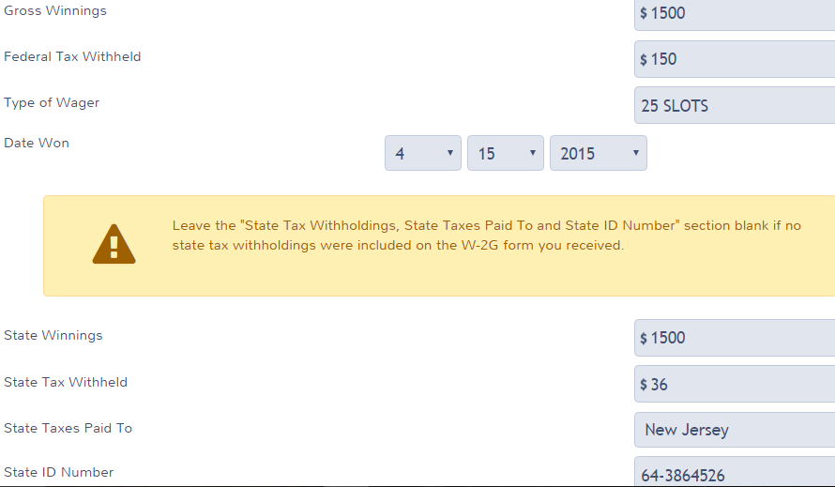
TS - Federal Gambling Winnings – W-2G Federal section \ Income \ Enter Myself \ Other Income \ Gambling Winnings (W2-G)
Gross winnings
Leave state section blank unless
State taxes were withheld
Notes:
7

Slide 8
TS - Federal Gambling Losses Federal section \ Deductions \ Enter Myself \ Itemized Deductions \ Miscellaneous Deductions
Losses (only up to the extent of winnings)
Note: If losses > winnings are entered, TaxSlayer will leave that amount on this screen, and it will flow through to Schedule A
Notes:
8

Slide 9
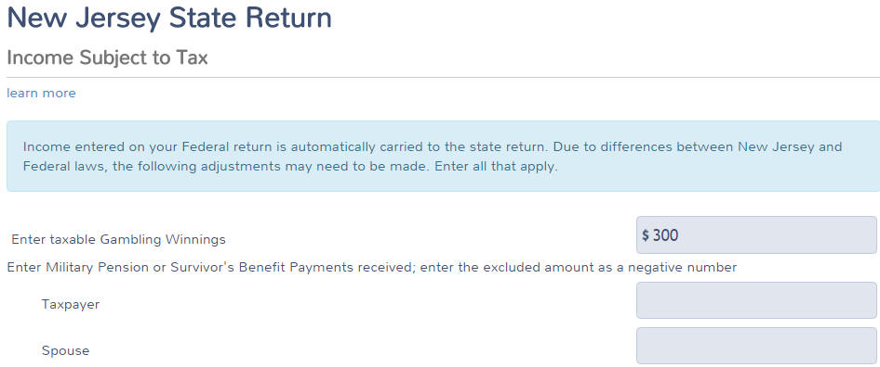
TS – NJ Net Gambling Winnings State section \ Edit \ Enter Myself \ Congratulations \ Income Subject to Tax
Net gambling winnings
(winnings minus losses), but not less than 0
Notes:
9

Slide 10
Jury Duty Pay
Jury Duty Pay must be included in Other Income on 1040 line 21
Enter in Federal section \ Income \ Enter Myself \ Other Income \ Other Inc. Not Reported Elsewhere
Some employers pay taxpayers during jury duty periods and require jury duty compensation to be turned over to them
Amount returned to employer can be claimed as an adjustment on 1040 Line 35 (covered in later module)
Notes:
10

Slide 11
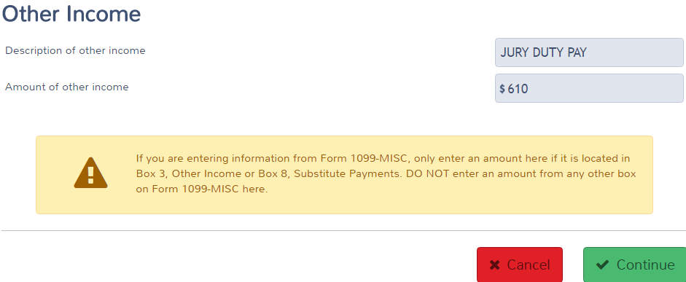
TS – Jury Duty Pay Federal section \ Income \ Enter Myself \ Other Income \ Other Inc. Not Reported Elsewhere
Description of other income
Jury duty pay
Notes:
11

Slide 12
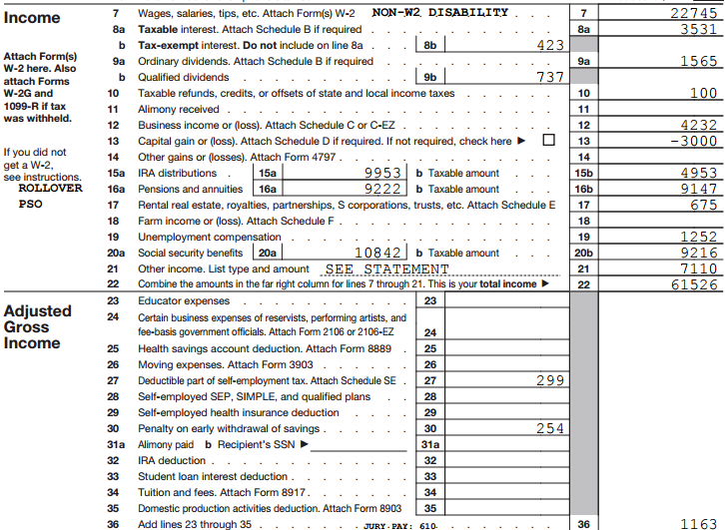
TS - Other Income – Federal 1040 Lines 21 and 36
Other income
Jury duty pay returned to employer
Notes:
12

Slide 13
Recoveries
Pub 17 Chapter 12
Recoveries of amounts deducted in prior years may have to be reported as Other Income in current year. May include:
Property tax rebates (e.g. - PTR & Homestead Benefit) – covered in more detail in later module
Reimbursements for medical expenses claimed in prior years
Other refunds of Schedule A deductions
Use State Refund Worksheet in TaxSlayer to determine how much of recovery is taxable (if prior year info is available)
NJ property tax recoveries are not taxable in NJ. Since 1040 Line 21 Other Income totals flow through to NJ 1040 Line 25, have to adjust NJ 1040 Line 25 Other Income . Capture property tax recovery info on NJ Checklist for later entry in the State section
Notes:
Handling of property tax recoveries will be handled in a separate module later in training
13

Slide 14
Cancellation of Credit Card Debt
Cancellation of credit card debt is in scope for all counselors as part of Advanced certification
Reported on 1099-C
1099-C income taxable on Federal return
Exception: taxpayer in bankruptcy or insolvent (liabilities exceeded assets) immediately before debt was cancelled
If bankrupt or insolvent, Out of Scope
See Pub 4012 page D-46 and specific instructions in Special Topics document on TaxPrep4Free.org Preparer page
Notes:
14

Slide 15
Cancellation of Credit Card Debt
Enter in Federal section \ Income \ Enter Myself \ Other Income Cancellation of Debt (1099-C, Form 982) \ Cancellation of Debt (Form 1099-C)
1099-C income is not taxable in NJ
Since 1040 Line 21 Other Income totals flow through to NJ 1040 Line 25, have to adjust NJ 1040 Line 25 Other Income. Capture 1099-C amount on NJ Checklist for later entry in the State section
Notes:
15

Slide 16
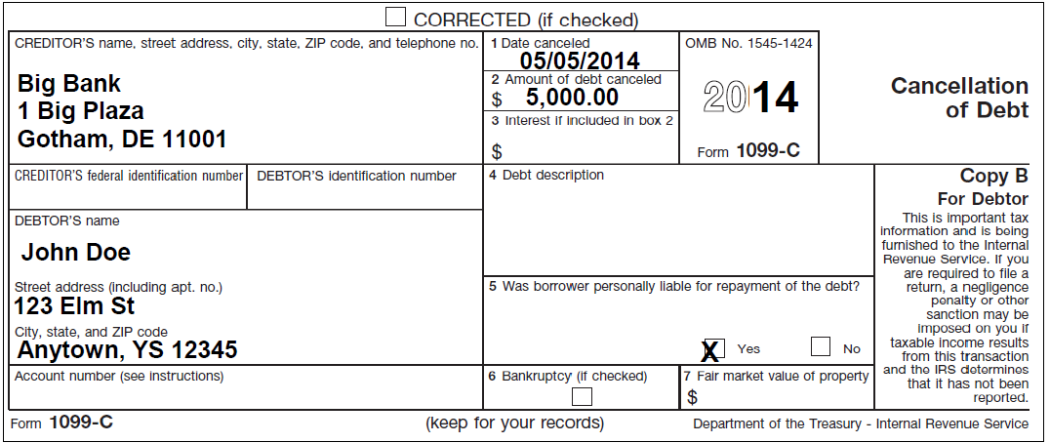
Cancellation of Credit Card Debt – 1099-C
Amount to be included
as income on 1040 Line 21
5
15
Notes:
16

Slide 17
TS - Cancellation of Credit Card Debt Federal section \ Income \ Enter Myself \ Other Income \ Cancellation of Debt (1099-C, Form 982) \ Cancellation of Debt (Form 1099-C)
Amount of debt cancelled
Notes:
17

Slide 18
Foreclosures/Abandonments and Cancellation of Debt on Mortgage
Foreclosure/Abandonments and Cancellation of Debt on a home mortgage loan has been declared Out of Scope for NJ preparers due to its complexity
Refer to Pub 4012 Pages D-50 through D-52 for details on the screening process and entry into TaxSlayer
If taxpayer had a portion of mortgage debt cancelled but kept the home (loan modification or mortgage workout), the amount of debt discharged reduces the cost basis of the principal residence
Refer to Pub 4012 Page D-52
Notes:
Cancellation of debt on a home mortgage is Out of Scope for NJ preparers, but is In Scope for AARP TaxAide in general. Therefore, there is a question about loan modification on the IRS test (Advanced Scenario 6, question 17). The information about cost basis for a loan modification is needed for that question
18

Slide 19
Income from Long-Term Care Insurance Contracts
Income received from Long-Term Care Insurance Contracts is In Scope
Generally reimbursements are not taxable
Per diem costs up to an aggregate limit are not taxable
Reported on 1099-LTC
Enter in Federal section \ Deductions \ Enter Myself \ Adjustments \ Medical Savings Accounts (Form 8853) \ Form 8853 Medical Savings Account
Use section “Long Term Care (LTC) Insurance Contracts”
See specific instructions in Special Topic document on TaxPrep4Free.org Preparer page
Notes:
19

Slide 20
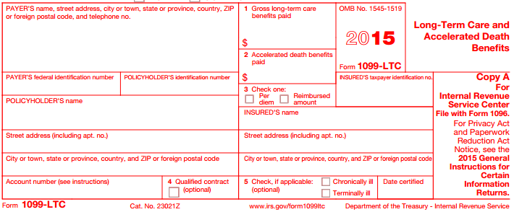
TS – L/T Care Insurance Contracts – 1099-LTC
Notes:
Box 3 tells you whether long-term care insurance contract income is a per diem amount or a reimbursed amount
Per-diem plan payments are not taxable up to $330 per day. If per-diem payments received are less than $330 per day, the payments are excludable from gross income
Reimbursed amounts that are less than the actual cost of qualified care are excludable from gross income
20

Slide 21
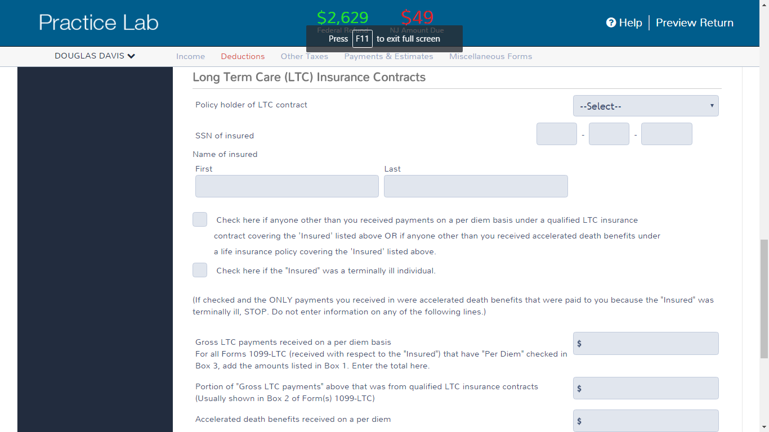
TS – L/T Care Insurance Contracts – 1099-LTC Federal section \ Deductions \ Enter Myself \ Adjustments \ Medical Savings Accounts (Form 8853) \ Form 8853 Medical Savings Account
Notes:
21

Slide 22
TS – Supporting Statement for Other Income in PDF File
Notes:
22

